Slide 1

A+ Guide to Hardware, 9th Edition
Chapter 2
Working Inside Desktop Computers and Laptops
Notes:
1
A+ Guide to Hardware, 9th Edition
Chapter 2
Working Inside Desktop Computers and Laptops

Slide 2
Objectives
Take apart a desktop computer and put it back together
Explain the special considerations when supporting laptop computers that are different than supporting desktop computers
Take apart a laptop computer and put it back together
Notes:
Objectives
Take apart a desktop computer and put it back together
Explain the special considerations when supporting laptop computers that are different than supporting desktop computers
Take apart a laptop computer and put it back together

Slide 3
How to Work Inside a Desktop Computer Case
Every PC technician should know how to take a computer apart and put it back together again
The following slides will cover this skill
Notes:
How to Work Inside a Desktop Computer Case
Every PC technician should know how to take a computer apart and put it back together again
The following slides will cover this skill

Slide 4
Step 1: Plan and Organize Your Work
Make notes for backtracking
Remove loose jewelry that might get caught
Stay organized by keeping small parts in one place
Do not stack boards on top of each other
Do not touch board chips
With hands, magnetized screwdriver
Fingerprints on edge connectors may later cause corrosion
Notes:
Step 1: Plan and Organize Your Work
Make notes for backtracking
Remove loose jewelry that might get caught
Stay organized by keeping small parts in one place
Do not stack boards on top of each other
Do not touch board chips
With hands, magnetized screwdriver
Fingerprints on edge connectors may later cause corrosion

Slide 5
Step 1: Plan and Organize Your Work
Protect yourself and the equipment
Don’t touch a microchip with a magnetized screwdriver
Never ever touch inside of a turned on computer
Consider monitor, power supply as “black boxes”
Never remove the cover or touch inside
Watch out for sharp edges that can cut
Notes:
Step 1: Plan and Organize Your Work
Protect yourself and the equipment
Don’t touch a microchip with a magnetized screwdriver
Never ever touch inside of a turned on computer
Consider monitor, power supply as “black boxes”
Never remove the cover or touch inside
Watch out for sharp edges that can cut

Slide 6
Step 2: Open the Computer Case and Examine the System
Back up important data
Power down the system and unplug it
Unplug other peripherals as well
Press and hold the power button for 3 seconds
This will drain the power supply
Have a plastic bag or cup handy to hold screws
Open the case cover
Many cases require you to remove the faceplate first
Some older cases require you to remove a side panel
Notes:
Step 2: Open the Computer Case and Examine the System
Back up important data
Power down the system and unplug it
Unplug other peripherals as well
Press and hold the power button for 3 seconds
This will drain the power supply
Have a plastic bag or cup handy to hold screws
Open the case cover
Many cases require you to remove the faceplate first
Some older cases require you to remove a side panel

Slide 7
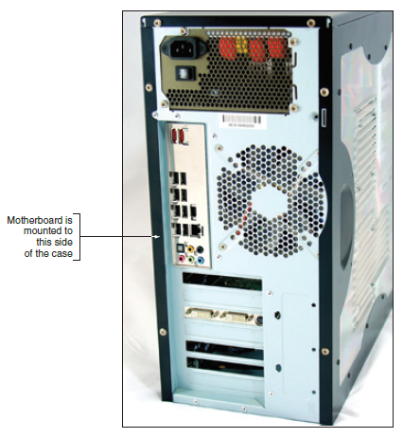
Step 2: Open the Computer Case and Examine the System
Figure 2-1 Decide which side panel to remove
Notes:
Step 2: Open the Computer Case and Examine the System
Back up important data
Power down the system and unplug it
Unplug other peripherals as well
Press and hold the power button for 3 seconds
This will drain the power supply
Have a plastic bag or cup handy to hold screws
Open the case cover
Many cases require you to remove the faceplate first
Some older cases require you to remove a side panel

Slide 8
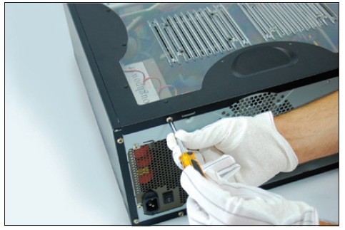
Step 2: Open the Computer Case and Examine the System
Figure 2-2 Locate the screws that hold the side panel in place
Notes:
Step 2: Open the Computer Case and Examine the System
Back up important data
Power down the system and unplug it
Unplug other peripherals as well
Press and hold the power button for 3 seconds
This will drain the power supply
Have a plastic bag or cup handy to hold screws
Open the case cover
Many cases require you to remove the faceplate first
Some older cases require you to remove a side panel

Slide 9
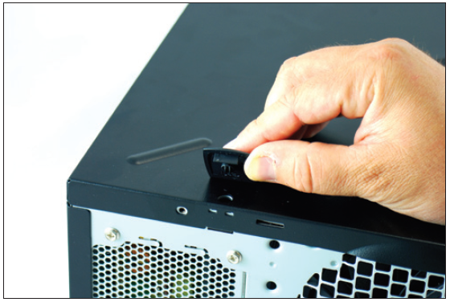
Step 2: Open the Computer Case and Examine the System
Figure 2-3 On this system, clips hold the side panel in place
Notes:
Step 2: Open the Computer Case and Examine the System
Back up important data
Power down the system and unplug it
Unplug other peripherals as well
Press and hold the power button for 3 seconds
This will drain the power supply
Have a plastic bag or cup handy to hold screws
Open the case cover
Many cases require you to remove the faceplate first
Some older cases require you to remove a side panel

Slide 10
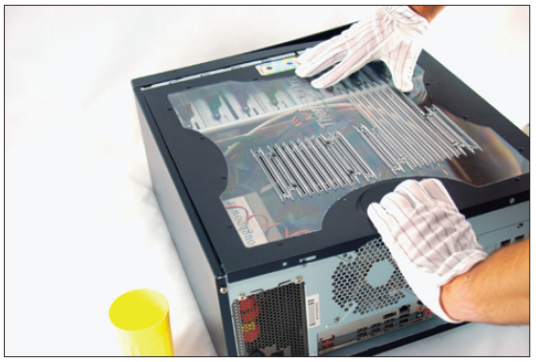
Step 2: Open the Computer Case and Examine the System
Figure 2-4 Slide the panel to the rear of the case
Notes:
Step 2: Open the Computer Case and Examine the System
Back up important data
Power down the system and unplug it
Unplug other peripherals as well
Press and hold the power button for 3 seconds
This will drain the power supply
Have a plastic bag or cup handy to hold screws
Open the case cover
Many cases require you to remove the faceplate first
Some older cases require you to remove a side panel

Slide 11
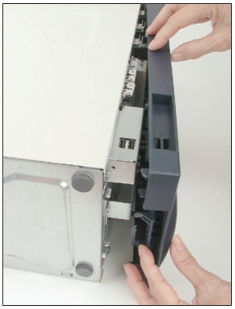
Step 2: Open the Computer Case and Examine the System
Figure 2-5 Some cases require you to remove the front panel
before removing the side panel of a computer case
Notes:
Step 2: Open the Computer Case and Examine the System
Back up important data
Power down the system and unplug it
Unplug other peripherals as well
Press and hold the power button for 3 seconds
This will drain the power supply
Have a plastic bag or cup handy to hold screws
Open the case cover
Many cases require you to remove the faceplate first
Some older cases require you to remove a side panel

Slide 12
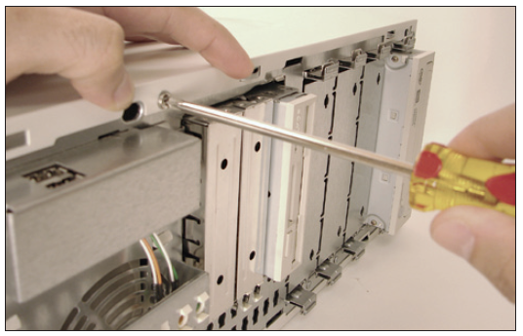
Step 2: Open the Computer Case and Examine the System
Figure 2-6 One screw holds the side panel in place
Notes:
Step 2: Open the Computer Case and Examine the System
Back up important data
Power down the system and unplug it
Unplug other peripherals as well
Press and hold the power button for 3 seconds
This will drain the power supply
Have a plastic bag or cup handy to hold screws
Open the case cover
Many cases require you to remove the faceplate first
Some older cases require you to remove a side panel

Slide 13
Step 2: Open the Computer Case and Examine the System
Clip your ESD strap to the side of the computer case
After opening you will see the main components:
Power supply
Motherboard
Drives
Follow cables from motherboard to the component to know the purpose of each cable
Notes:
Step 2: Open the Computer Case and Examine the System
Clip your ESD strap to the side of the computer case
After opening you will see the main components:
Power supply
Motherboard
Drives
Follow cables from motherboard to the component to know the purpose of each cable

Slide 14
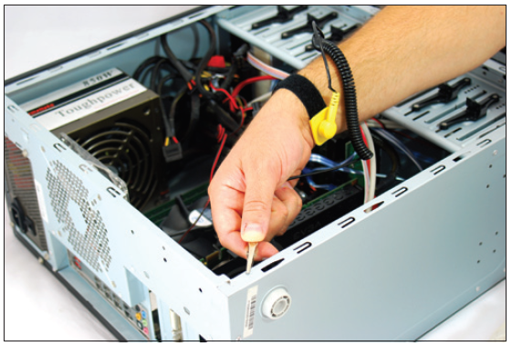
Step 2: Open the Computer Case and Examine the System
Figure 2-7 Attach the alligator clip of your ground bracelet to the side of the computer case
Notes:
Step 2: Open the Computer Case and Examine the System
Back up important data
Power down the system and unplug it
Unplug other peripherals as well
Press and hold the power button for 3 seconds
This will drain the power supply
Have a plastic bag or cup handy to hold screws
Open the case cover
Many cases require you to remove the faceplate first
Some older cases require you to remove a side panel

Slide 15
Step 3: Remove Expansion Cards
If removing components:
Draw a diagram of all cable connections to the motherboard, expansion cards, and drives
Use a felt-tip marker to mark components in order to indicate a cable connection, board placement, orientation, etc…
Notes:
Step 3: Remove Expansion Cards
If removing components:
Draw a diagram of all cable connections to the motherboard, expansion cards, and drives
Use a felt-tip marker to mark components in order to indicate a cable connection, board placement, orientation, etc…

Slide 16
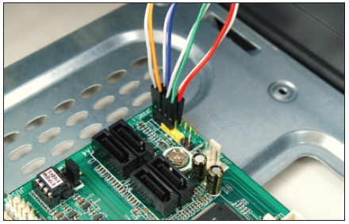
Step 3: Remove Expansion Cards
Figure 2-8 Diagram the pin locations of the color-coded
wires that connect to the front of the case
Notes:
Step 3: Remove Expansion Cards
If removing components:
Draw a diagram of all cable connections to the motherboard, expansion cards, and drives
Use a felt-tip marker to mark components in order to indicate a cable connection, board placement, orientation, etc…

Slide 17
Step 3: Remove Expansion Cards
To remove expansion cards:
Remove any wire or cable connected to the card
Remove the screw holding the card to the case
Grasp the card with both hands and remove it by lifting straight up (can also rock the card from end to end)
Don’t put your fingers on edge connectors or touch a chip
It is best to store cards in an antistatic bag
Notes:
Step 3: Remove Expansion Cards
To remove expansion cards:
Remove any wire or cable connected to the card
Remove the screw holding the card to the case
Grasp the card with both hands and remove it by lifting straight up (can also rock the card from end to end)
Don’t put your fingers on edge connectors or touch a chip
It is best to store cards in an antistatic bag

Slide 18
Step 4: Remove the Motherboard, Power Supply, and Drives
Depending on the system, you may have to remove the drives and/or power supply to get to the motherboard
To remove motherboard:
Unplug power supply lines
Unplug SATA cables connected to the motherboard
Disconnect wires leading from the front of the computer case to the motherboard (called front panel connectors)
Make a diagram before disconnecting
Notes:
Step 4: Remove the Motherboard, Power Supply, and Drives
Depending on the system, you may have to remove the drives and/or power supply to get to the motherboard
To remove motherboard:
Unplug power supply lines
Unplug SATA cables connected to the motherboard
Disconnect wires leading from the front of the computer case to the motherboard (called front panel connectors)
Make a diagram before disconnecting

Slide 19
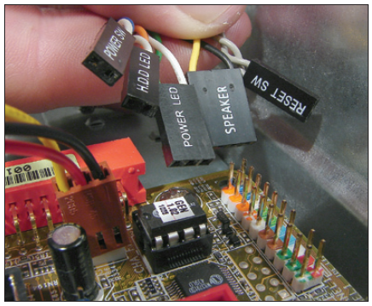
Step 4: Remove the Motherboard, Power Supply, and Drives
Figure 2-9 Five leads from the front panel connect to two rows
of pins on the motherboard front panel header
Notes:
Step 4: Remove the Motherboard, Power Supply, and Drives
Depending on the system, you may have to remove the drives and/or power supply to get to the motherboard
To remove motherboard:
Unplug power supply lines
Unplug SATA cables connected to the motherboard
Disconnect wires leading from the front of the computer case to the motherboard (called front panel connectors)
Make a diagram before disconnecting

Slide 20
Step 4: Remove the Motherboard, Power Supply, and Drives
To remove motherboard (cont’d):
Disconnect any other cables or wires connected to the motherboard
Unscrew motherboard from spacers
Spacers (standoffs): round plastic or metal pegs that separate the board from the case
Spacers are necessary to keep motherboard from touching the metal case, which might cause a short
Motherboard should be free to remove from the case
Notes:
Step 4: Remove the Motherboard, Power Supply, and Drives
To remove motherboard (cont’d):
Disconnect any other cables or wires connected to the motherboard
Unscrew motherboard from spacers
Spacers (standoffs): round plastic or metal pegs that separate the board from the case
Spacers are necessary to keep motherboard from touching the metal case, which might cause a short
Motherboard should be free to remove from the case

Slide 21
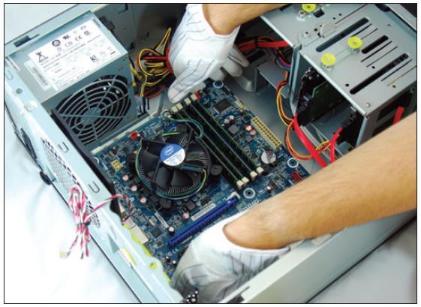
Step 4: Remove the Motherboard, Power Supply, and Drives
Figure 2-10 Remove the motherboard from the case
Notes:
Step 4: Remove the Motherboard, Power Supply, and Drives
To remove motherboard (cont’d):
Disconnect any other cables or wires connected to the motherboard
Unscrew motherboard from spacers
Spacers (standoffs): round plastic or metal pegs that separate the board from the case
Spacers are necessary to keep motherboard from touching the metal case, which might cause a short
Motherboard should be free to remove from the case

Slide 22
Step 4: Remove the Motherboard, Power Supply, and Drives
To remove the power supply from the case:
Look for screws that attach the power supply to the computer case
Do not remove screws that hold power supply housing together (do take housing apart)
Sometimes power supplies are also attached to the case on the underside by recessed slots
Turn case over and look for slots
If present, determine in which direction you need to slide the power supply to free it from the case
Notes:
Step 4: Remove the Motherboard, Power Supply, and Drives
To remove the power supply from the case:
Look for screws that attach the power supply to the computer case
Do not remove screws that hold power supply housing together (do take housing apart)
Sometimes power supplies are also attached to the case on the underside by recessed slots
Turn case over and look for slots
If present, determine in which direction you need to slide the power supply to free it from the case

Slide 23
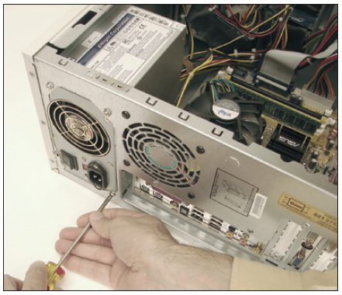
Step 4: Remove the Motherboard, Power Supply, and Drives
Figure 2-11 Removing the power supply mounting screws
Notes:
Step 4: Remove the Motherboard, Power Supply, and Drives
To remove motherboard (cont’d):
Disconnect any other cables or wires connected to the motherboard
Unscrew motherboard from spacers
Spacers (standoffs): round plastic or metal pegs that separate the board from the case
Spacers are necessary to keep motherboard from touching the metal case, which might cause a short
Motherboard should be free to remove from the case

Slide 24
Step 4: Remove the Motherboard, Power Supply, and Drives
Tips to remove drives:
Look for screws on each side of the drive attaching the drive to the drive bay
There might be a catch underneath the drive
You must lift up as you slide the drive forward
Some drive bays have a clipping mechanism to hold the drive in the bay
Release the clip and then pull the drive forward
May have to remove the drive bay in order to remove the drives
Notes:
Step 4: Remove the Motherboard, Power Supply, and Drives
Tips to remove drives:
Look for screws on each side of the drive attaching the drive to the drive bay
There might be a catch underneath the drive
You must lift up as you slide the drive forward
Some drive bays have a clipping mechanism to hold the drive in the bay
Release the clip and then pull the drive forward
May have to remove the drive bay in order to remove the drives

Slide 25
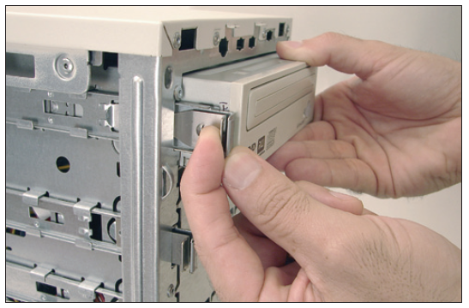
Step 4: Remove the Motherboard, Power Supply, and Drives
Figure 2-12 To remove this CD drive, first pull the clip forward to
release the drive from the bay
Notes:
Step 4: Remove the Motherboard, Power Supply, and Drives
To remove motherboard (cont’d):
Disconnect any other cables or wires connected to the motherboard
Unscrew motherboard from spacers
Spacers (standoffs): round plastic or metal pegs that separate the board from the case
Spacers are necessary to keep motherboard from touching the metal case, which might cause a short
Motherboard should be free to remove from the case

Slide 26
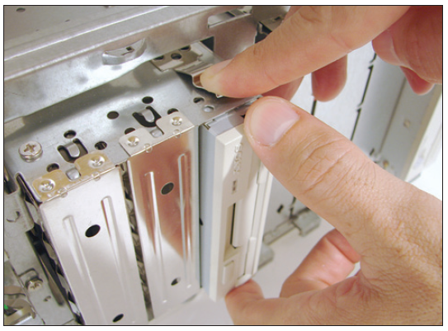
Step 4: Remove the Motherboard, Power Supply, and Drives
Figure 2-13 Push down on the clip and then slide the removable
bay forward and out of the case
Notes:
Step 4: Remove the Motherboard, Power Supply, and Drives
To remove motherboard (cont’d):
Disconnect any other cables or wires connected to the motherboard
Unscrew motherboard from spacers
Spacers (standoffs): round plastic or metal pegs that separate the board from the case
Spacers are necessary to keep motherboard from touching the metal case, which might cause a short
Motherboard should be free to remove from the case

Slide 27
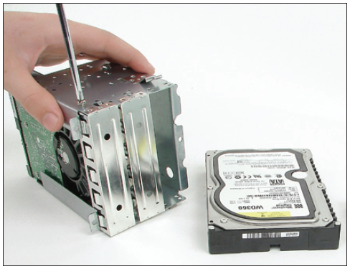
Step 4: Remove the Motherboard, Power Supply, and Drives
Figure 2-14 Drives in this removable bay are held in place with
screws on each side of the bay
Notes:
Step 4: Remove the Motherboard, Power Supply, and Drives
To remove motherboard (cont’d):
Disconnect any other cables or wires connected to the motherboard
Unscrew motherboard from spacers
Spacers (standoffs): round plastic or metal pegs that separate the board from the case
Spacers are necessary to keep motherboard from touching the metal case, which might cause a short
Motherboard should be free to remove from the case

Slide 28
Steps to Put a Computer Back Together
Refer to any diagrams created during the disassembling process
Install components in this order: power supply, drives, motherboard, and cards
When installing drives, it may be easier to connect cables to the drives before sliding them into the bay
Place motherboard inside the case
Make sure ports and screw holes are lined up
Notes:
Steps to Put a Computer Back Together
Refer to any diagrams created during the disassembling process
Install components in this order: power supply, drives, motherboard, and cards
When installing drives, it may be easier to connect cables to the drives before sliding them into the bay
Place motherboard inside the case
Make sure ports and screw holes are lined up

Slide 29
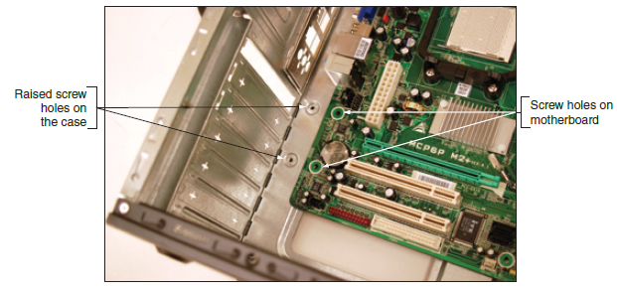
Steps to Put a Computer Back Together
Figure 2-15 Align screw holes in the case with those on the motherboard
Notes:
Steps to Put a Computer Back Together
Refer to any diagrams created during the disassembling process
Install components in this order: power supply, drives, motherboard, and cards
When installing drives, it may be easier to connect cables to the drives before sliding them into the bay
Place motherboard inside the case
Make sure ports and screw holes are lined up

Slide 30
Steps to Put a Computer Back Together
Connect the power cords from the power supply to the motherboard
Will always need the main P1 power connector and may likely need the 4-pin auxiliary connector for the processor
A board might have a 6-pin or 8-pin PCIe power connector
If power supply does not have this connector, use an adapter to convert two Molex connectors to a PCIe connector
Notes:
Steps to Put a Computer Back Together
Connect the power cords from the power supply to the motherboard
Will always need the main P1 power connector and may likely need the 4-pin auxiliary connector for the processor
A board might have a 6-pin or 8-pin PCIe power connector
If power supply does not have this connector, use an adapter to convert two Molex connectors to a PCIe connector

Slide 31
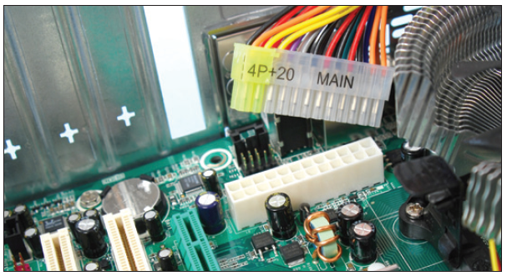
Steps to Put a Computer Back Together
Figure 2-16 The 24-pin connector supplies power to the motherboard
Notes:
Steps to Put a Computer Back Together
Refer to any diagrams created during the disassembling process
Install components in this order: power supply, drives, motherboard, and cards
When installing drives, it may be easier to connect cables to the drives before sliding them into the bay
Place motherboard inside the case
Make sure ports and screw holes are lined up

Slide 32
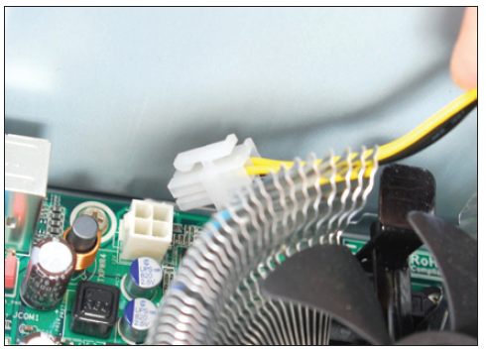
Steps to Put a Computer Back Together
Figure 2-17 The auxiliary 4-pin power cord provides power to the processor
Notes:
Steps to Put a Computer Back Together
Refer to any diagrams created during the disassembling process
Install components in this order: power supply, drives, motherboard, and cards
When installing drives, it may be easier to connect cables to the drives before sliding them into the bay
Place motherboard inside the case
Make sure ports and screw holes are lined up

Slide 33
Steps to Put a Computer Back Together
Connect the power cords from the power supply to the motherboard (cont’d):
If case fan is present, connect power cord from the fan to pins on motherboard labeled “Fan Header”
If a CPU and cooler are already installed on motherboard, connect power cord from CPU to pins on motherboard labeled “Fan Header”
Connect wire leads from the front panel of the case to the front panel header on motherboard
Notes:
Steps to Put a Computer Back Together
Connect the power cords from the power supply to the motherboard (cont’d):
If case fan is present, connect power cord from the fan to pins on motherboard labeled “Fan Header”
If a CPU and cooler are already installed on motherboard, connect power cord from CPU to pins on motherboard labeled “Fan Header”
Connect wire leads from the front panel of the case to the front panel header on motherboard

Slide 34
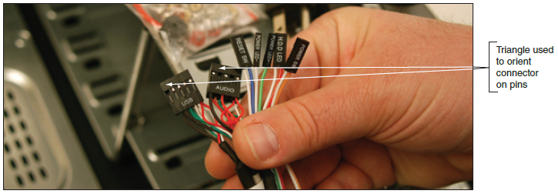
Steps to Put a Computer Back Together
Figure 2-18 Seven connectors from the front panel connect to the motherboard
Notes:
Steps to Put a Computer Back Together
Refer to any diagrams created during the disassembling process
Install components in this order: power supply, drives, motherboard, and cards
When installing drives, it may be easier to connect cables to the drives before sliding them into the bay
Place motherboard inside the case
Make sure ports and screw holes are lined up

Slide 35
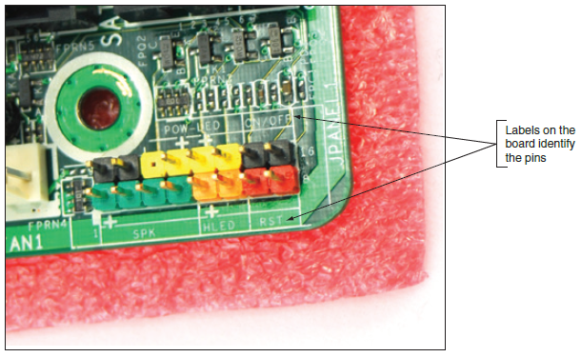
Steps to Put a Computer Back Together
Figure 2-19 Front panel header uses color-coded pins and labels
Notes:
Steps to Put a Computer Back Together
Refer to any diagrams created during the disassembling process
Install components in this order: power supply, drives, motherboard, and cards
When installing drives, it may be easier to connect cables to the drives before sliding them into the bay
Place motherboard inside the case
Make sure ports and screw holes are lined up

Slide 36
Steps to Put a Computer Back Together
Look for a small triangle embedded on the connector that marks one of the outside wires as pin 1
Line up pin 1 on connector with pin 1 marked on motherboard
If labels on motherboard are not clear, consult user guide for help
Notes:
Steps to Put a Computer Back Together
Look for a small triangle embedded on the connector that marks one of the outside wires as pin 1
Line up pin 1 on connector with pin 1 marked on motherboard
If labels on motherboard are not clear, consult user guide for help

Slide 37
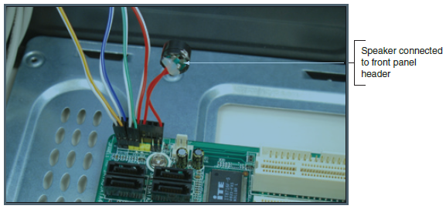
Steps to Put a Computer Back Together
Figure 2-20 Front panel header with all connectors in place
Notes:
Steps to Put a Computer Back Together
Look for a small triangle embedded on the connector that marks one of the outside wires as pin 1
Line up pin 1 on connector with pin 1 marked on motherboard
If labels on motherboard are not clear, consult user guide for help

Slide 38
Steps to Put a Computer Back Together
Connect wires to ports on the front panel of the case
Audio ports or USB ports are examples
Install the video card and other expansion cards
Double-check each connection
Plug in keyboard, monitor, and mouse
In classroom environment, have instructor check work
Turn on the power and check that the PC is working properly
If not, most likely a loose connection
Notes:
Steps to Put a Computer Back Together
Connect wires to ports on the front panel of the case
Audio ports or USB ports are examples
Install the video card and other expansion cards
Double-check each connection
Plug in keyboard, monitor, and mouse
In classroom environment, have instructor check work
Turn on the power and check that the PC is working properly
If not, most likely a loose connection

Slide 39
Special Considerations when Supporting Laptops
Laptops and their replacement parts cost more than desktop PCs
Factors to consider that apply more to laptop than desktop computers:
Original equipment manufacturer’s warranty
Service manuals and diagnostic software provided by the manufacturer
Customized installation of the OS unique to laptops
Advantage of order replacement parts directly from the laptop manufacturer or authorized source
Notes:
Special Considerations when Supporting Laptops
Laptops and their replacement parts cost more than desktop PCs
Factors to consider that apply more to laptop than desktop computers:
Original equipment manufacturer’s warranty
Service manuals and diagnostic software provided by the manufacturer
Customized installation of the OS unique to laptops
Advantage of order replacement parts directly from the laptop manufacturer or authorized source

Slide 40
Warranty Concerns
Always check to see if laptop is under warranty before servicing
Contacting technical support: information needed
Laptop model and serial number
Purchaser name, phone number, address
Service options
On-site
Ship to authorized service center
Phone assistance or online chat
Notes:
Warranty Concerns
Always check to see if laptop is under warranty before servicing
Contacting technical support: information needed
Laptop model and serial number
Purchaser name, phone number, address
Service options
On-site
Ship to authorized service center
Phone assistance or online chat

Slide 41
Service Manuals and Other Sources of Information
Service manuals save time
Enables safe laptop disassembly
Locating documentation – Service manual
Manufacturer’s physical manual
Manufacturer’s Web site
Support or FAQ pages
Third party websites
User manual
Provides basic maintenance tasks
Notes:
Service Manuals and Other Sources of Information
Service manuals save time
Enables safe laptop disassembly
Locating documentation – Service manual
Manufacturer’s physical manual
Manufacturer’s Web site
Support or FAQ pages
Third party websites
User manual
Provides basic maintenance tasks

Slide 42
Diagnostic Tools Provided by Manufacturers
To determine problem components use diagnostic software provided by manufacturer
Sources:
Manufacturer’s Web site
CDs bundled with the notebook
Hard drive or floppy disk
Example: PC-Doctor
Included with Lenovo, Fujitsu, and HP notebooks
Can be purchased separately
Notes:
Diagnostic Tools Provided by Manufacturers
To determine problem components use diagnostic software provided by manufacturer
Sources:
Manufacturer’s Web site
CDs bundled with the notebook
Hard drive or floppy disk
Example: PC-Doctor
Included with Lenovo, Fujitsu, and HP notebooks
Can be purchased separately

Slide 43
How to Work Inside a Laptop Computer
It may become necessary to open a laptop case to upgrade memory, exchange a hard drive, or replace a failed component
Replacing a broken LCD panel or motherboard can be a complex process
Screws and nuts on a laptop are smaller than a desktop
Require smaller tools
Notes:
How to Work Inside a Laptop Computer
It may become necessary to open a laptop case to upgrade memory, exchange a hard drive, or replace a failed component
Replacing a broken LCD panel or motherboard can be a complex process
Screws and nuts on a laptop are smaller than a desktop
Require smaller tools

Slide 44
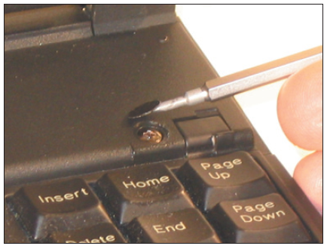
How to Work Inside a Laptop Computer
Requires special tools and extra patience
Figure 2-21 Use a small screwdriver or dental pick to pry up the plastic cover hiding a screw
Notes:
How to Work Inside a Laptop Computer

Slide 45
How to Work Inside a Laptop Computer
Requires special tools and extra patience
Figure 2-22 To protect the system against ESD, attach the alligator clip of a ground strap to an I/O port on the back of the laptop
Notes:
How to Work Inside a Laptop Computer

Slide 46
How to Work Inside a Laptop Computer
Many small screws require smaller tools
Work methodically:
Keep screws and components organized
Place screws in a pillbox (label each compartment)
Place screws on soft padded work surface
Use white labeling tape
Place screws on notebook paper
Write where screw belongs
Tape screw beside manufacturer documentation
Keep notes to help with reassembly
Notes:
How to Work Inside a Laptop Computer
Many small screws require smaller tools
Work methodically:
Keep screws and components organized
Place screws in a pillbox (label each compartment)
Place screws on soft padded work surface
Use white labeling tape
Place screws on notebook paper
Write where screw belongs
Tape screw beside manufacturer documentation
Keep notes to help with reassembly

Slide 47
How to Work Inside a Laptop Computer
Figure 2-23 Tape screws beside the step in the manufacturer documentation that told you to remove the screw
Notes:
How to Work Inside a Laptop Computer

Slide 48
How to Work Inside a Laptop Computer
Disassembly tips:
Find the hardware service manual
Consider the warranty might still apply
Opening the case might void the warranty
Take the time necessary, do not force anything
Protect against ESD
Understand ZIF connectors
Pry up plastic covers with dental pick or screwdriver
Plastic screws may be used only once
Disassemble components in order
Notes:
How to Work Inside a Laptop Computer
Disassembly tips:
Find the hardware service manual
Consider the warranty might still apply
Opening the case might void the warranty
Take the time necessary, do not force anything
Protect against ESD
Understand ZIF connectors
Pry up plastic covers with dental pick or screwdriver
Plastic screws may be used only once
Disassemble components in order

Slide 49
How to Work Inside a Laptop Computer
Figure 2-24 Three ZIF connectors hold the three keyboard cables in place
Notes:
How to Work Inside a Laptop Computer

Slide 50
How to Work Inside a Laptop Computer
Reassembly tips:
Reassemble notebook in reverse order
Tighten, but do not over tighten, all screws
Before installing the battery or AC adapter verify there are no loose parts inside the notebook
Notes:
How to Work Inside a Laptop Computer
Reassembly tips:
Reassemble notebook in reverse order
Tighten, but do not over tighten, all screws
Before installing the battery or AC adapter verify there are no loose parts inside the notebook

Slide 51
Summary
When working inside a computer, stay organized, keep careful notes, and follow all safety procedures
Before opening a case, shut down the system, unplug it, disconnect all cables, and press the power button to drain residual power
An expansion card fits in a slot on the motherboard and is anchored to the case by a single screw or clip
Laptop computers are designed for travel, so smaller and more durable replacement parts cost more than they do for desktops
Notes:
Summary
When working inside a computer, stay organized, keep careful notes, and follow all safety procedures
Before opening a case, shut down the system, unplug it, disconnect all cables, and press the power button to drain residual power
An expansion card fits in a slot on the motherboard and is anchored to the case by a single screw or clip
Laptop computers are designed for travel, so smaller and more durable replacement parts cost more than they do for desktops

Slide 52
Summary
The laptop manufacturer documentation are useful when disassembling, troubleshooting, and repairing a notebook
When an internal component needs replacing, consider the possibility of disabling the component and using an external peripheral device in its place
Replacing the laptop might be more cost effective than performing labor-intensive repairs
When disassembling a laptop, the manufacturer’s service manual is essential
Notes:
Summary
The laptop manufacturer documentation are useful when disassembling, troubleshooting, and repairing a notebook
When an internal component needs replacing, consider the possibility of disabling the component and using an external peripheral device in its place
Replacing the laptop might be more cost effective than performing labor-intensive repairs
When disassembling a laptop, the manufacturer’s service manual is essential

Slide 53
Summary
When upgrading components on a laptop, use components that are the same brand as the laptop
Follow directions in a service manual to disassemble a laptop
Notes:
Summary
When upgrading components on a laptop, use components that are the same brand as the laptop
Follow directions in a service manual to disassemble a laptop

